Slide 1

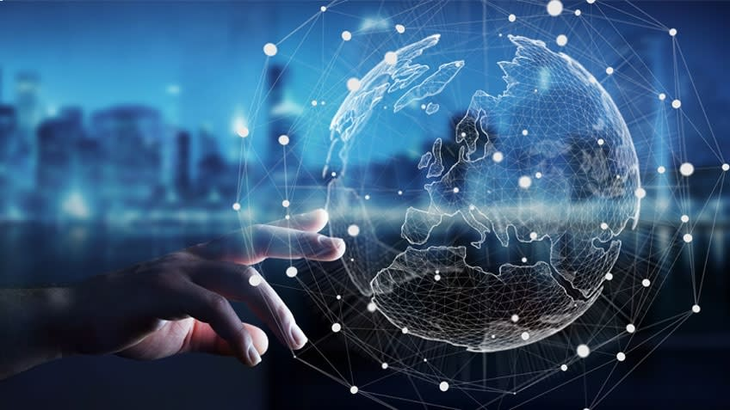
LEAP ACADEMY 4.0
DATA SCIENCE
TRIBE -D
IF ANALYTICS IS THE ENGINE THEN DATA IS THE FUEL OF THE 21ST CENTURY.
-SIMON QUINTON.

Slide 2
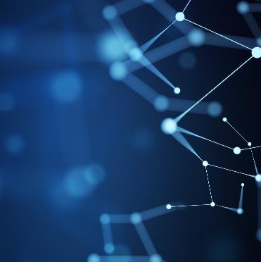
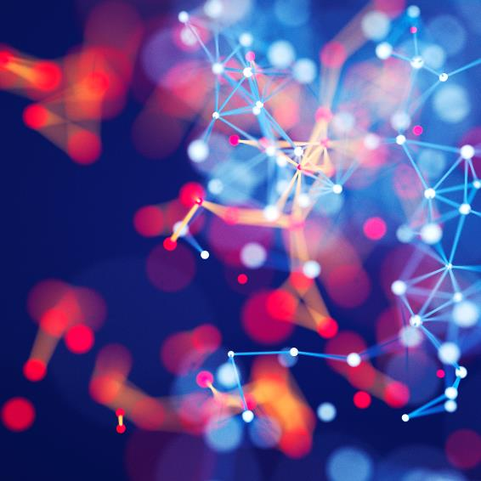
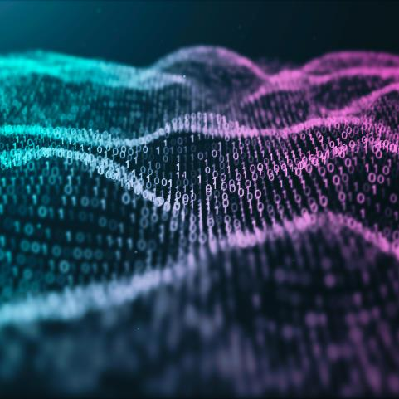
Agenda
Let’s Know About Data Science.
Our Objective.
Timeline.
Aspects Involved.
Knowledge Required.
Future Scope.

Slide 3




Introduction
DATA SCIENCE-
Fields using scientific methods, processes algorithms and systems to extract knowledge and ideas from structured and unstructured data.
IT’S NEED-
IT ENABLES ORGANISATIONS TO UNDERSTAND GIGANTIC DATA FROM MULTIPLE SORCES TO HELP MAKE DATA-DRIVEN DECISIONS.

Slide 4

OBJECTIVE
CONVERTING UNSTRUCTURED DATA INTO STRUCTURED ONE USING MACHINE LEARNING ALGORITHMS, WHICH WILL BUILD A PREDICTED MODEL.
TO IDENTIFY THE PATTERN EMBEDEED IN IT.

Slide 5
Timeline
INVOLVES DATA COLLECTION
DATA IMPORTING,
AND
DATA CLEANING
STAGE 11
NORMALIZING
STAGE 111
TEST SETS
AND
CLASSIFICATION.
STAGE 1V
STAGE V
DATA MODELLING
AND
ACCURACY CHECK.
APPLYING
ALGORITHMS.
STAGE 1

Slide 6
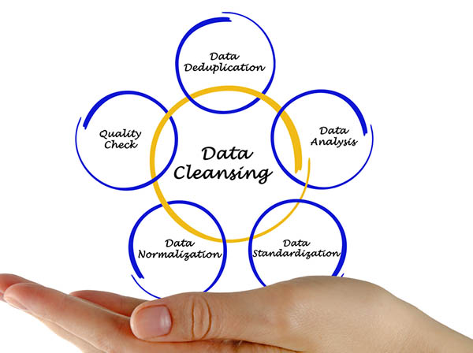
Aspects Involved-
DATA COLLECTION.
DATA CLEANING.
NORMALIZING.
Procedure of collecting, measuring and analyzing.
Detecting and correcting corrupt or inaccurate records from a record set, table.
The organization of data to appear similar across all records and fields.

Slide 7
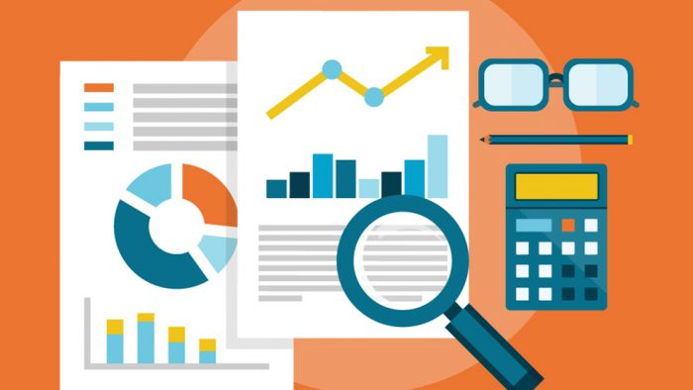
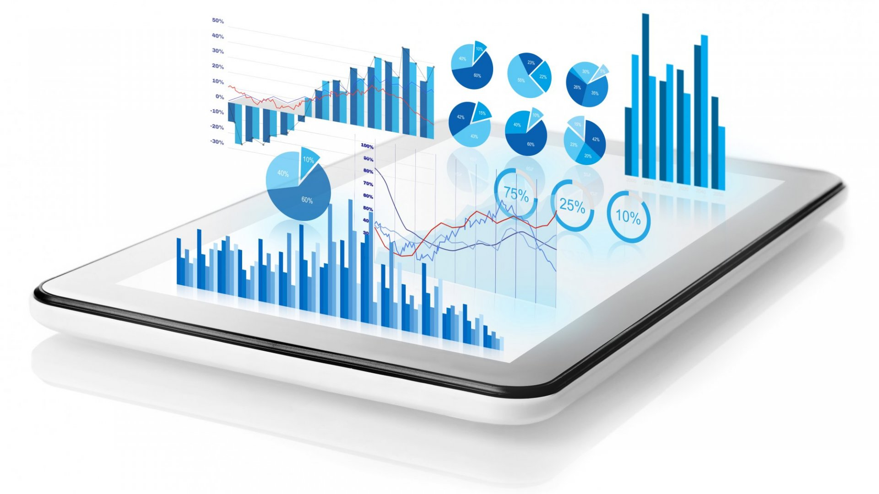
Aspects Involved-
DATA EVALUATION.
DATA MODELLING.
DATA VISUALIZATION.
Identification of research aim, presence of a research question, type, data collection processes.
Creating a visual representation of a whole information system.
Graphical representation of information and data.

Slide 8



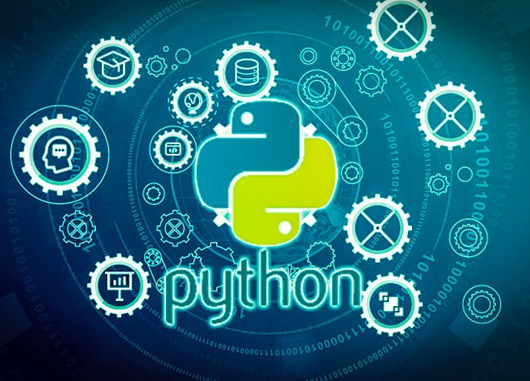

KNOWLEDGE REQUIRED-
TECHNOLOGY-
LANGUAGES-
APPLICATIONS-

Slide 9


FUTURE SCOPE & APPLICATIONS.
Data rules the world we live in. Thanks to the growth of Social Media, Smartphones, and Internet of Things, the amount of data at our disposal today is beyond Imagination.
Thus mostly the data is in semi-structured or unstructured format. This is where DATA SCIENCE comes in... With the use of AI and ML, it is being made easy to be dealt with.
Data Science has immensely contributed to Healthcare Sector. It’s Algorithms and Applications can be found in Genomic, Drug Development, Medical Image Analyst, Remote Monitoring, Product Monitoring and much more…

Slide 10
Team
JANAM SHARMA
MUSKAAN
MAYURI KHODADE
SNEHA EPARI
SACHIN BASAVARAD-DI
ADITYA BHANDARI
SNEHA YADAV

Slide 11
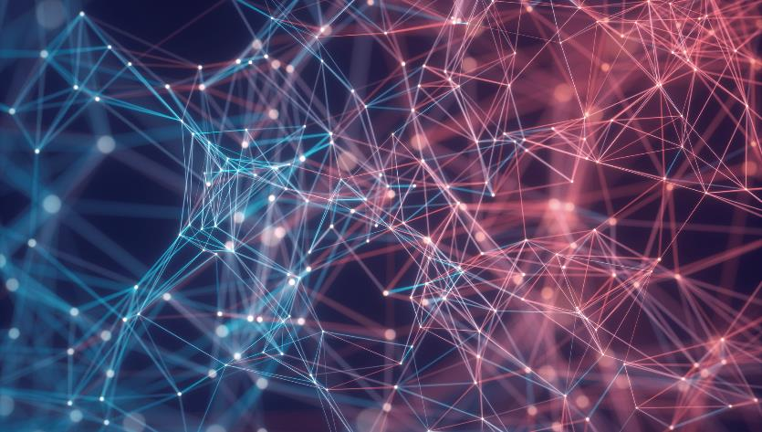

Thank You
TRIBE – D
GitHub LINK for BRD- https://www.github.com/janam5232/DTribe/tree/main/BRD_TRIBE-D.pdf

